Slide 1
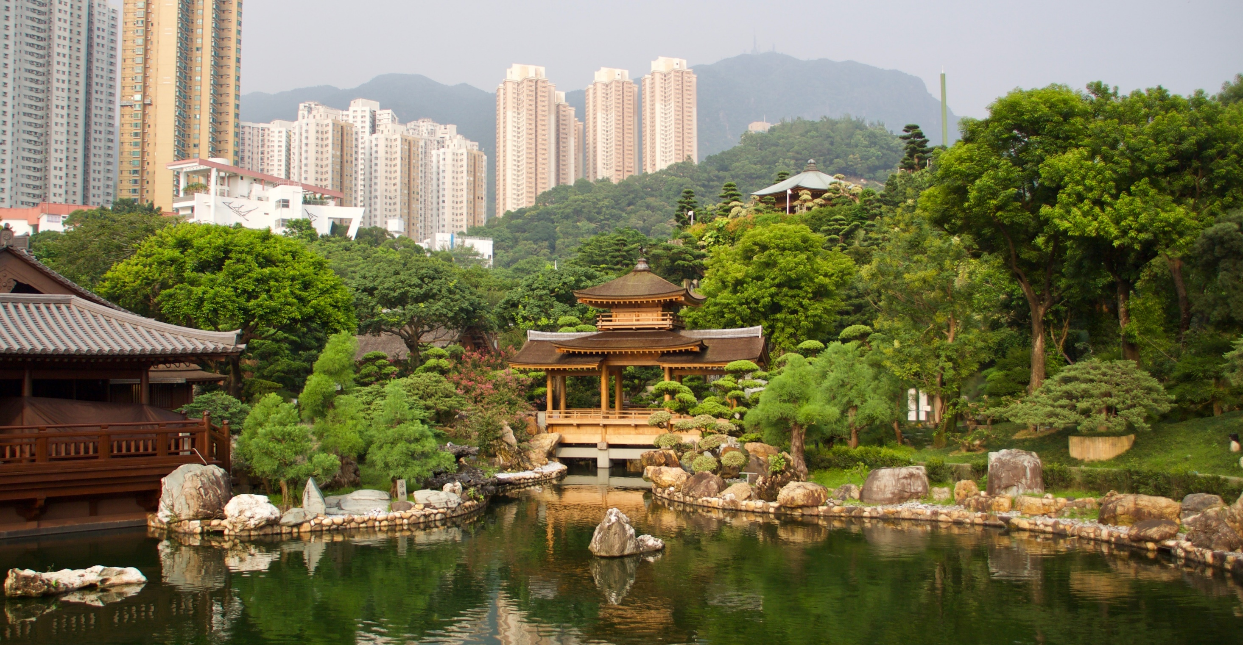
‘Spiritual place-making’ in urban landscapes
Christopher D. Ives¹, Jeremy Kidwell², Nicole Porter³ & Richard Irvine⁴
¹School of Geography, University of Nottingham. chris.ives@nottingham.ac.uk
²Department of Theology & Religion, University of Birmingham
³Department of Architecture and Built Environment, University of Nottingham
⁴Department of Social Anthropology, University of St Andrews

Slide 2
Spiritual values have received little attention
IPBES Summary Report (May 2019):
“Nature underpins quality of life by providing basic life support for humanity (regulating), as well as material goods (material) and spiritual inspiration (non-material) (well established) {2.3.1, 2.3.2}.”
The concept of ‘Spiritual inspiration’ is not unpacked further.
“Religion” received no mention.
Scholars have recently called for greater research into “human perception, values, and cultural traditions affecting the supply and demand of Ecosystem Services”
(McPhearson et al. 2015 Ecosystem Services, 12:152-156).

Slide 3
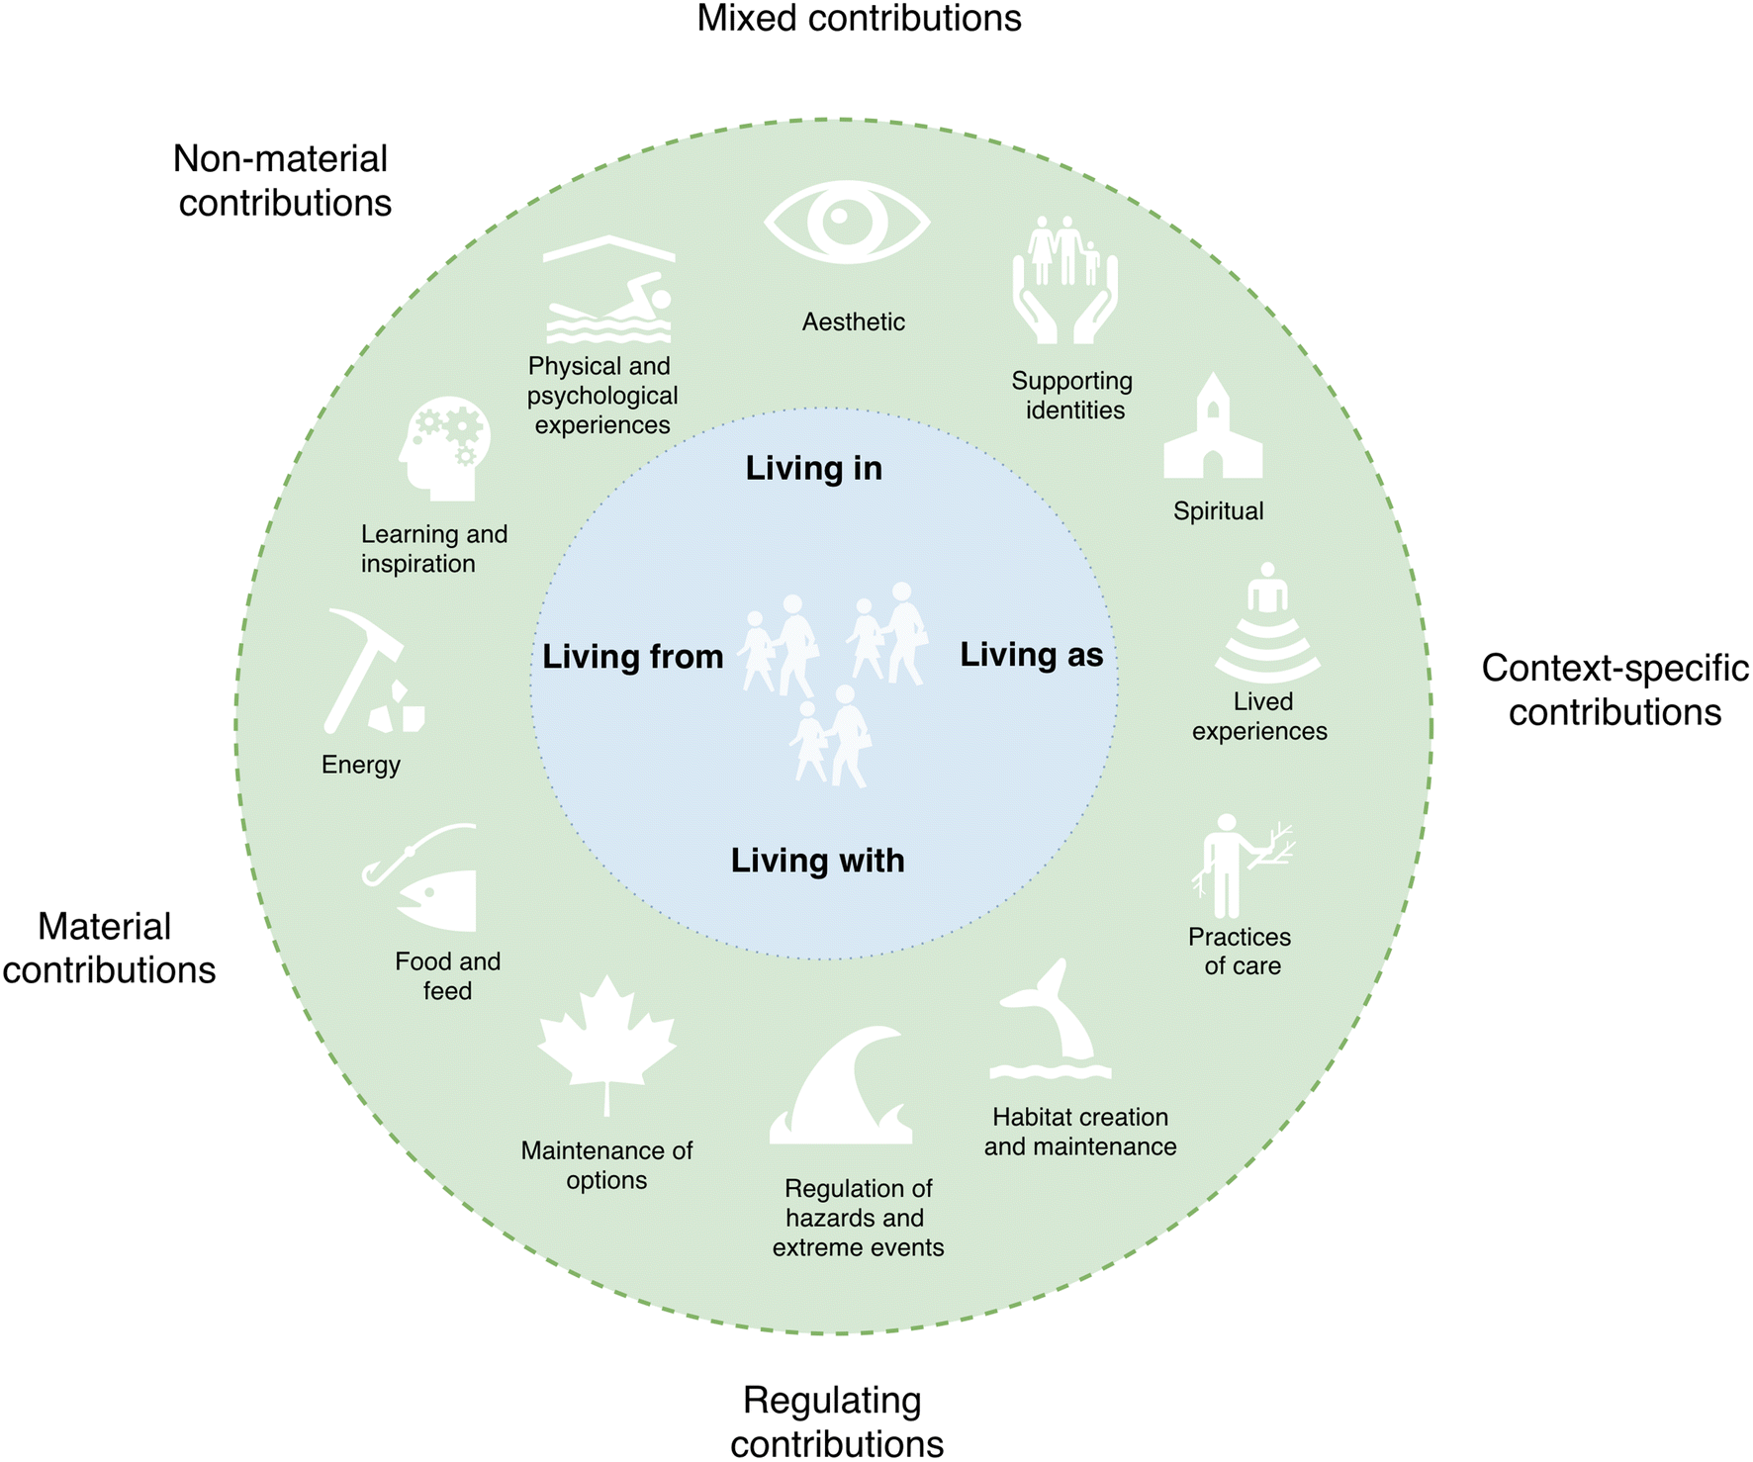
Existing conceptual frameworks
Nature’s Contributions to People (IPBES)
Life Framework of Values
Diaz et al. (2018) Science
O’Connor & Kenter (2019) Sustainability Science
Notes:
https://link.springer.com/article/10.1007/s11625-019-00715-7
https://science.sciencemag.org/content/359/6373/270.full

Slide 4
Research questions
How are cultural, spiritual, aesthetic, or religious values perceived, conceptualised, or understood in everyday urban environments?
What landscape features or socio-cultural influences shape the perception and expression of such values?
How can cultural, spiritual, aesthetic or religious values be categorised or operationalised for landscape decision-making?
There is a need for more empirically-grounded research.

Slide 5
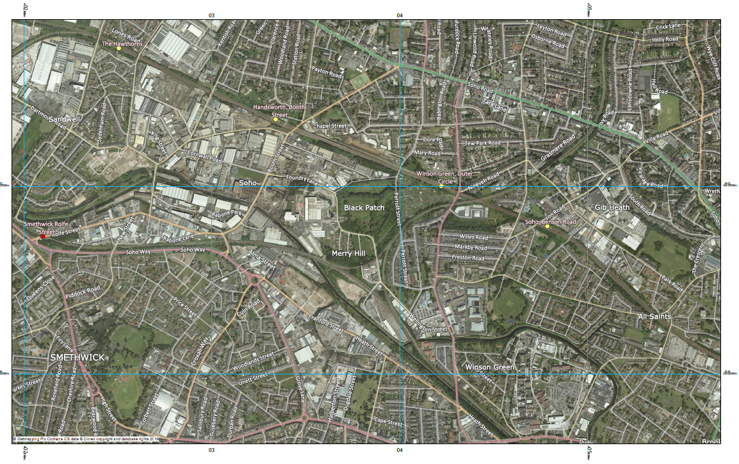
Case Study: Black Patch Park, Smethwick
Geography
Point of ecological confluence: meeting of watercourses
‘in-between’ place socially and administratively.
Positioned on an administrative boundary
Planning and Design
Site currently being considered as focal-point for urban renewal and investment.
Recent Sandwell planning statement and masterplan.
Notes:
Email from Richard:
It was a really great day at Black Patch on the 1st. There’s a lot more to the site than first meets the eye and it could be a really excellent case study. I think there’s a lot more I need to do to prepare myself to understand the site before the next visit – I need most especially to get a clearer handle on both the gypsy history and the more recent traveller activity there, and to try and consult with colleagues who have expertise in that area to that end.
I also learned (by a process of wild coincidence of someone sharing something on facebook about the Soho Foundry only days after I had returned home) that the historic landscape of the area is of far more significance than I had imagined, as a key site in the development of the industrial revolution (basically a Fordist factory a century before Ford) and as a kind of manifestation and showpiece of Birmingham enlightenment thought. It was closely associated with the Lunar Society, a highly influential late 18th century intellectual network. What we’re working on, then, is literally the furnace waste of the enlightenment. Well, maybe not quite so literally, but you get my point… there’s a very interesting narrative that leads us up to this moment in time.
And I shared with Jeremy this song written when there was a threat of building on the park itself: https://www.youtube.com/watch?v=6ezO4RdFwgg
Demographic statistics

Slide 6
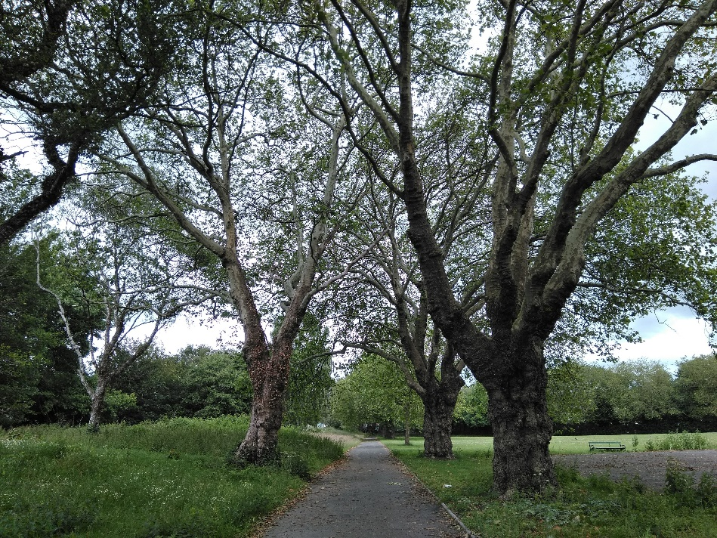
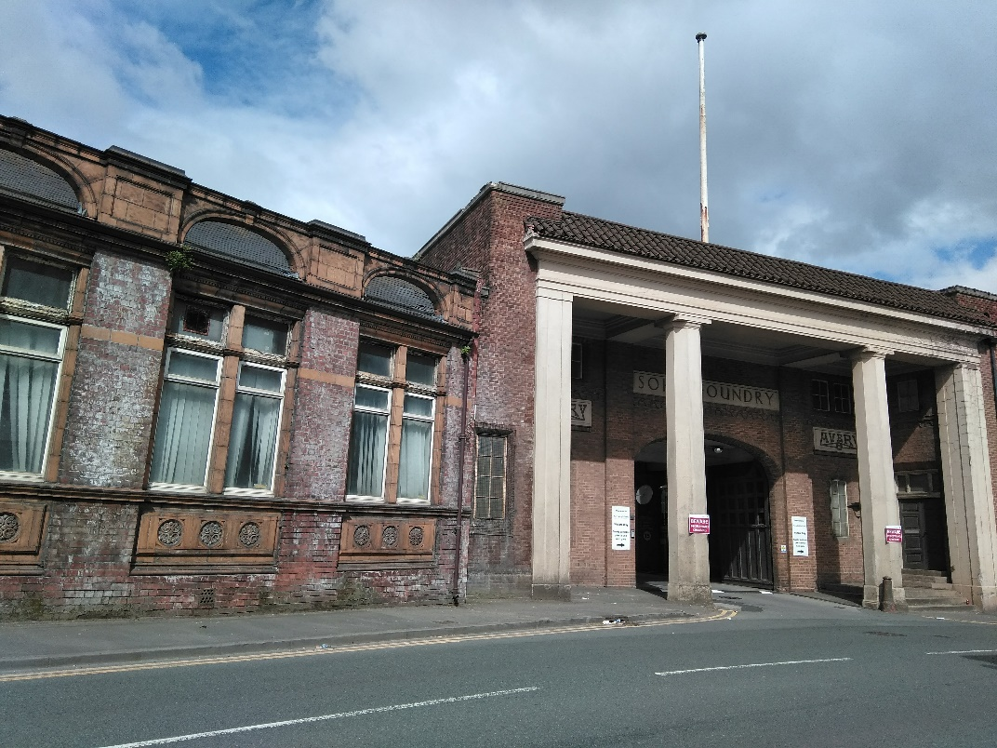
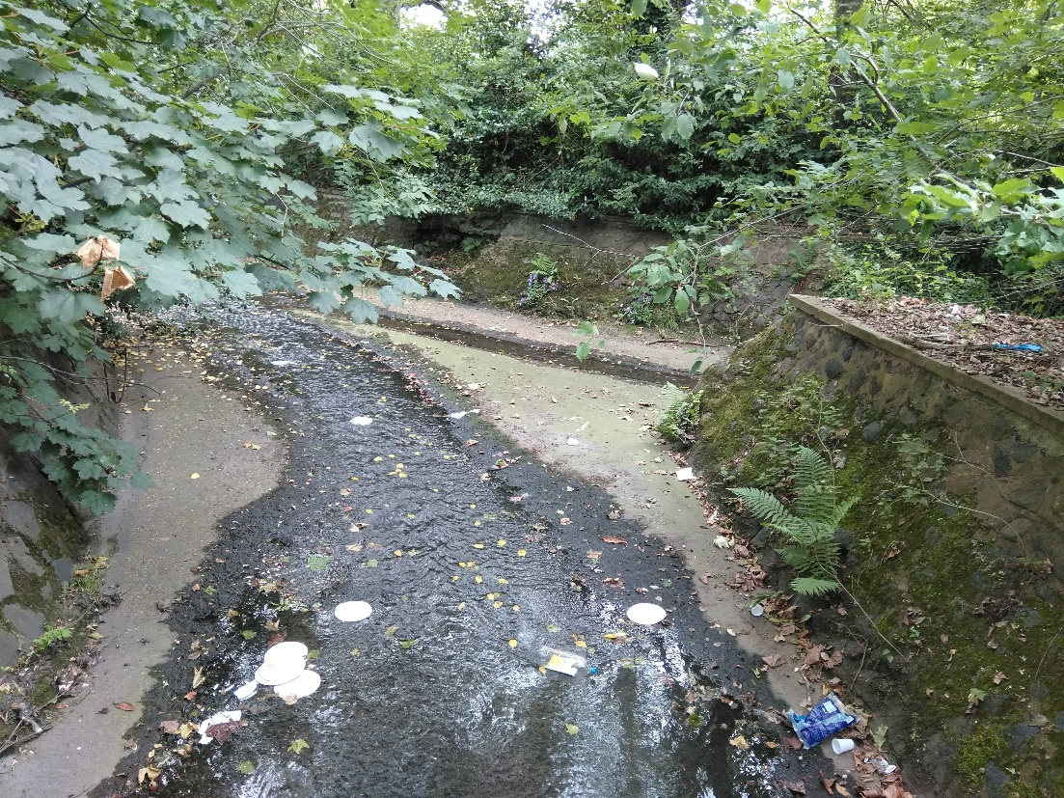

Slide 7
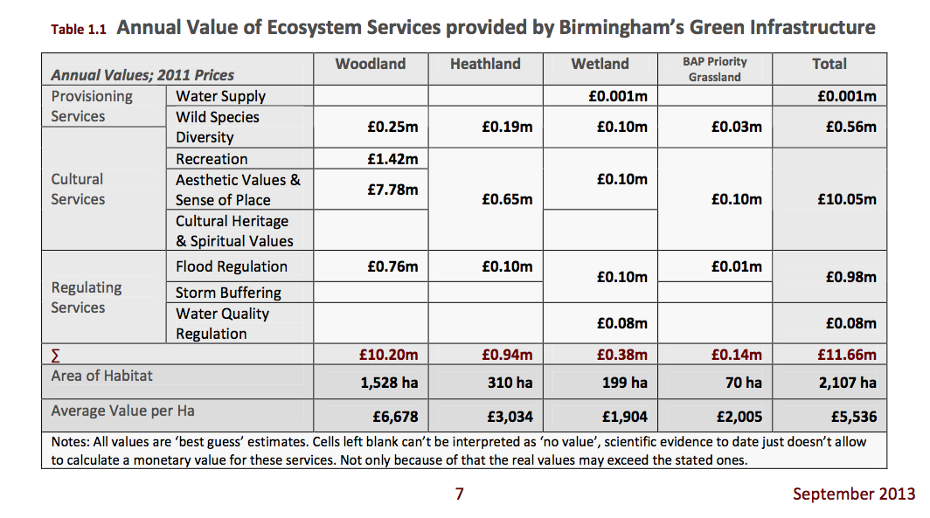
Spiritual values: the great ‘unknown’

Slide 8
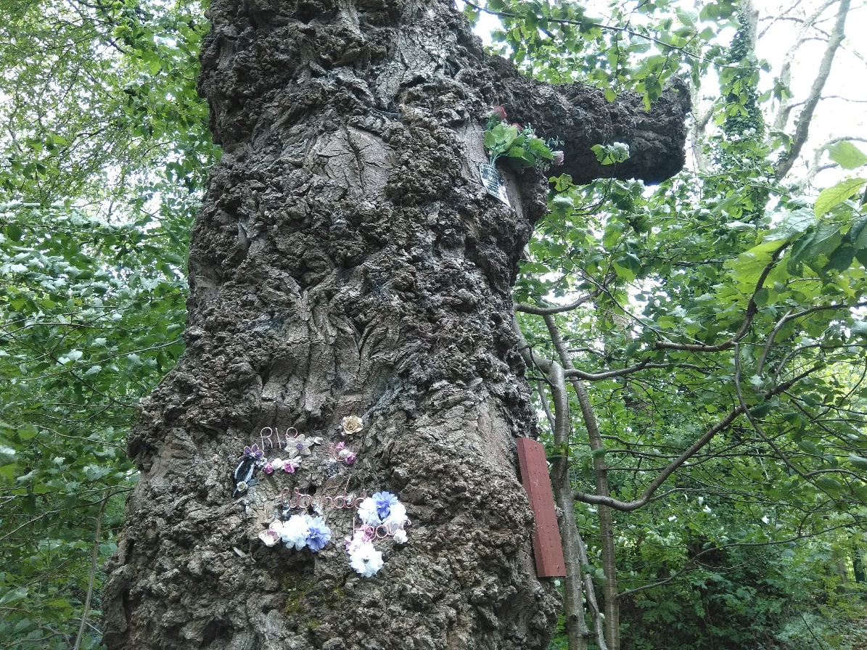
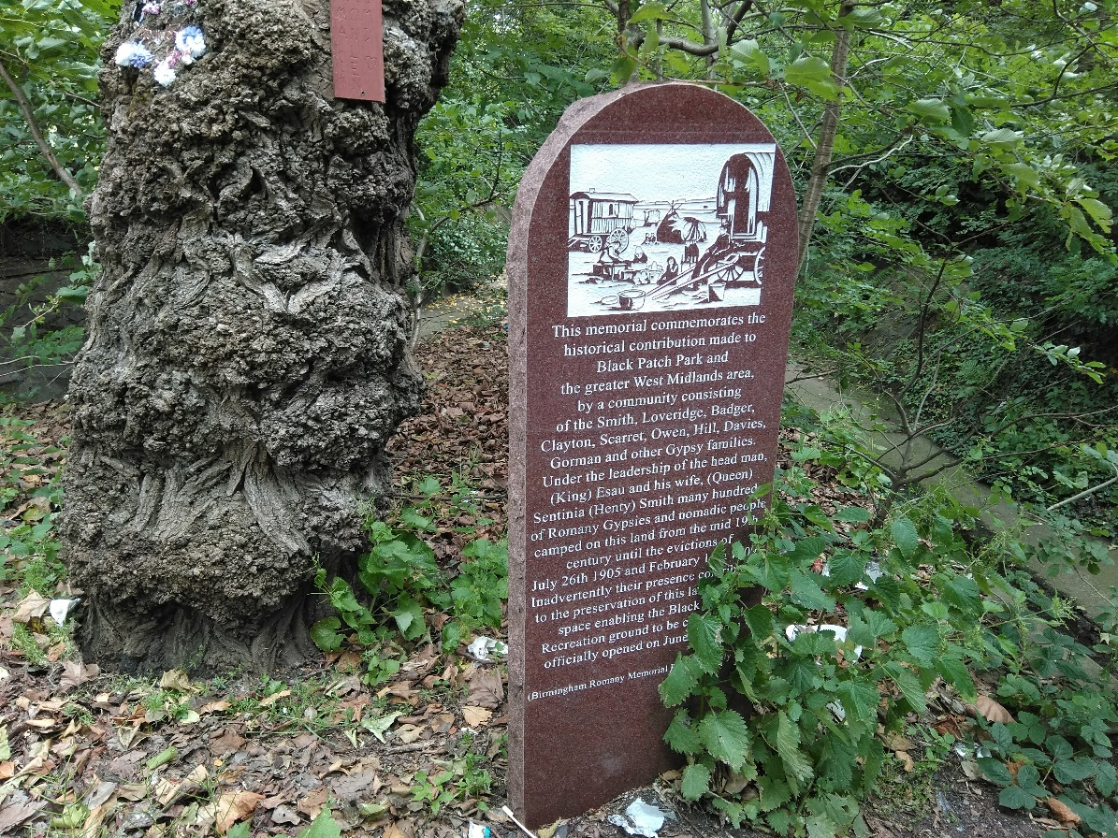
Signs of aesthetic, spiritual & cultural significance
Notes:
>> Give provide timeline of chronological overview
Development of the Black Patch area in Smethwick is an exciting opportunity for both universities to engage directly with the planning process to help shape tangible outcomes that benefit the local community and environment. With strong community support for the Interim Planning Statement garnered in the Summer of 2018, the proposed accompanying research alongside the development process is timely.
Insights gained from this research will benefit other Midlands jurisdictions as well. Birmingham City Council has example recently adopted a new ‘Green Living Spaces Plan’, which adopts insights from the UK’s National Ecosystem Assessment. It has also been identified as a member of a global network of ‘biophilic cities’.

Slide 9
It’s imperative to understand what was and what is (spiritually) if we are to imagine what could be…

Slide 10
Research Design
Scoping interviews
Stakeholder mapping
Primary interviews
Practitioner workshop
Academic workshop
Assessment guidelines
Diverse, interdisciplinary research team (geography, ethics, architecture, anthropology).
Notes:
Stakeholder mapping
‘Walking methodology’ for qualitative interviews
Develop ‘assessment framework’ for planners

Slide 11
Preliminary findings
Themes
“It’s a very spiritual place [Black Patch Park], but it is contested”
Spirituality is present, but not always formalised. Spiritual pluralism within groups (e.g. Friends of Black Patch Park)
Natural features are identified as carrying spiritual significance (e.g. creeks).
Some tension between planners and community members in how readily spiritual dimensions of this place are discussed.
Combination of care & neglect.

Slide 12
Emerging Questions
(without priming by researchers) do respondents consider the park to have ‘spiritual’ value(s)?
Are there barriers to spirituality that need to be overcome in formal planning contexts?
Degrees of comfort in articulating spirituality. What fora can provide space for this?
Notes:
Transience and place… Traveller communities, immigrant communities, group identity & difference…

Slide 13
Thank you
Email: chris.ives@nottingham.ac.uk
Twitter: @DrChrisIves

